Slide 1

ERPs in attention (P1, N1, P3) and emotion processing (LPP)
„Introduction to Electroencephalography“
Siyi Chen
Department of Psychology
LMU

Slide 2

What is Attention?
Attention permits us to focus on a subset of the incoming sensory information,
since we are not capable of processing all input.
Automatic selection
Voluntary
selection

Slide 3
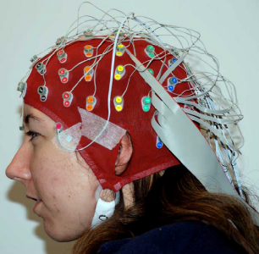
How is Attention studied in Psychology & Cognitive Neuroscience?
Whether attention modulates information processing at a sensory stage or at a later stage?
Behavioral paradigms
Limitation
Event related potentials - ERPs
Assessing the time course of processing
Determining which process is influenced by an experimental manipulation
Identifying multiple neurocognitive processes
Covert measurement of processing
A link to the brain

Slide 4
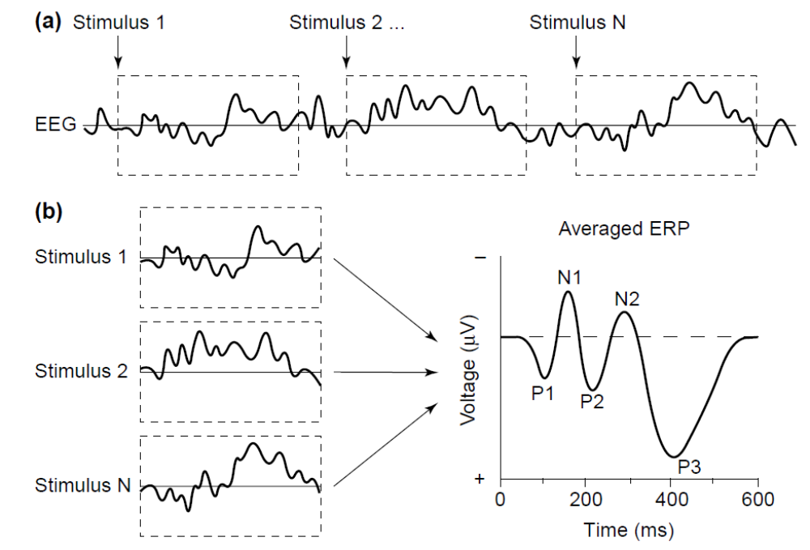
Event Related Potentials (ERPs)
Direction
Latency
Location

Slide 5
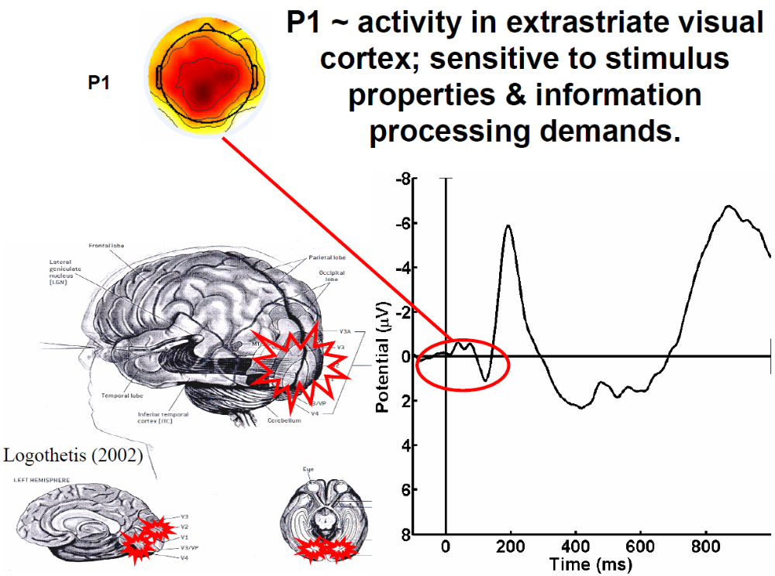
Visually evoked potentials
Extrastriate visual cortex
Stimulus parameters
Selective attention

Slide 6
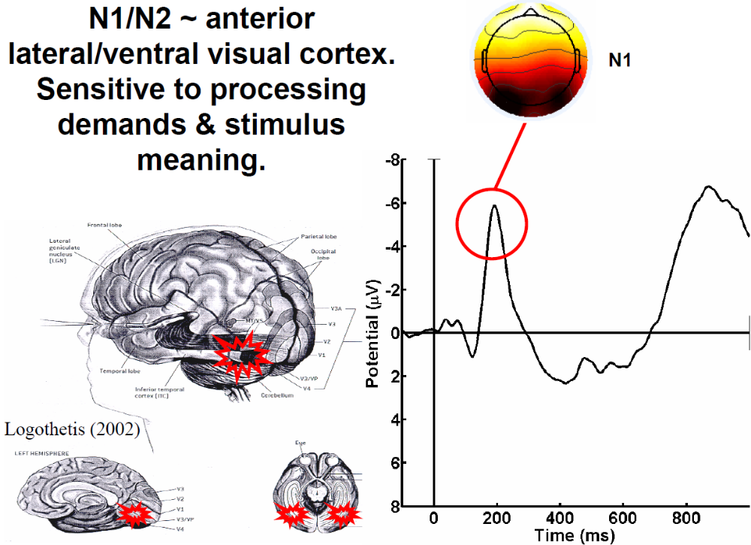
Visual evoked potential
Occipital, parietal, central, and frontal
Selective attention
Lateral occipital: discrimination

Slide 7
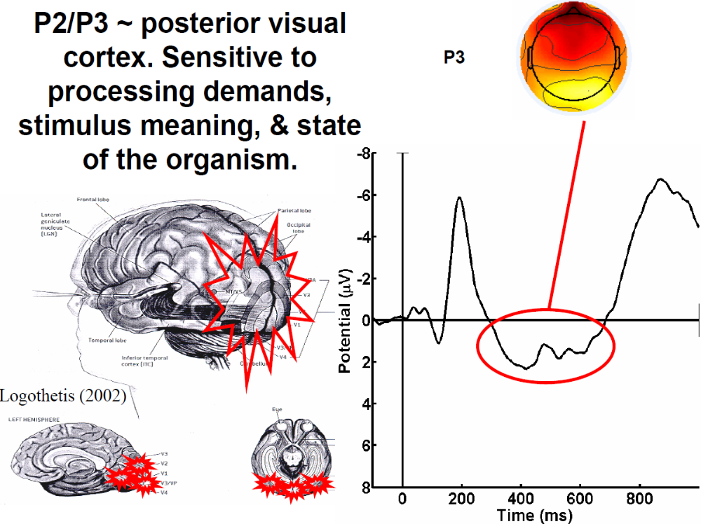
Endogenous potential
P3a : Frontal
Novelty
P3b (P3/P300): Parietal
Probability
Uncertainty
Resource allocation
Squires, Squires, and Hillyard (1975)
Johnson (1984, 1986)

Slide 8
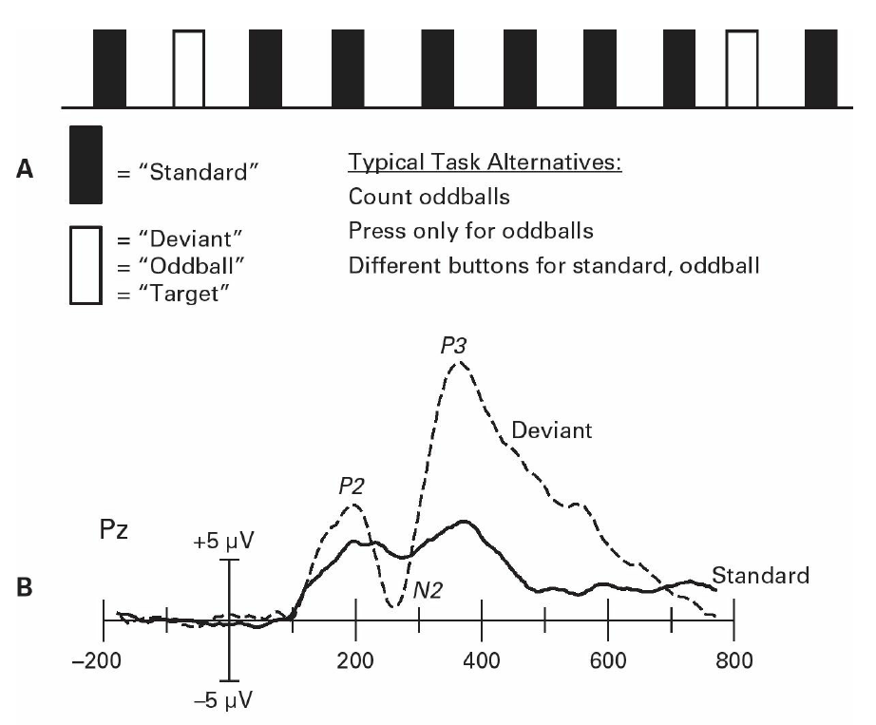
Oddball paradigm: P3

Slide 9
How is Attention studied in Psychology & Cognitive Neuroscience?
Whether attention modulates information processing at a sensory stage or at a later stage?
Evidence from Event related potentials - ERPs

Slide 10
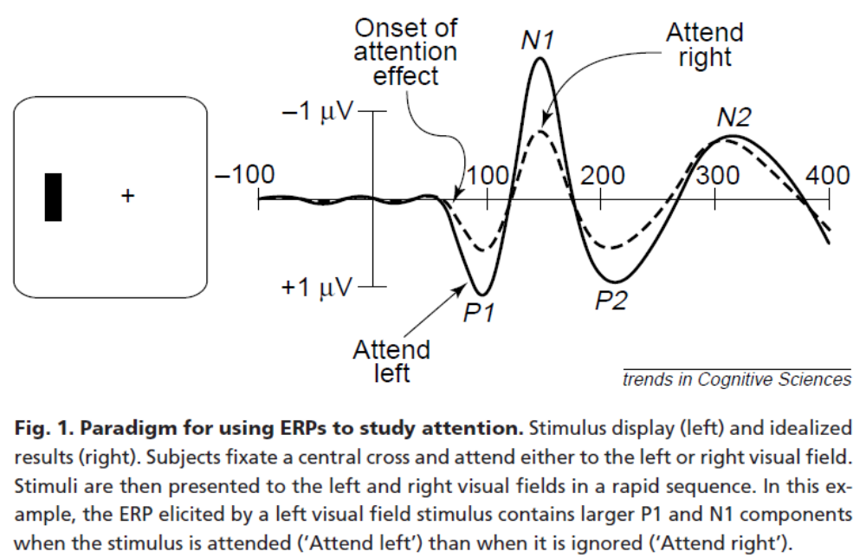
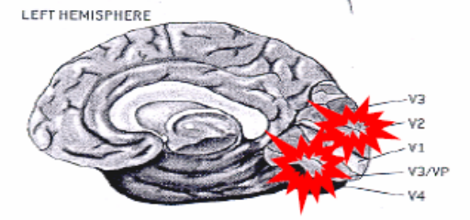
ERP evidence for early selection
Early ERP components in response to attended stimuli are larger than for unattended stimuli.
extrastriate visual areas
Attention influences sensory coding.
Luck, S.J. and Hillyard, S.A. (1999)

Slide 11
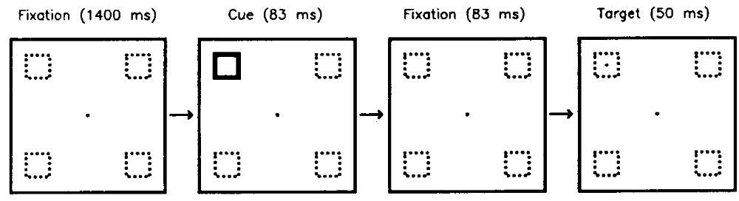
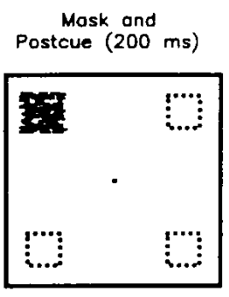
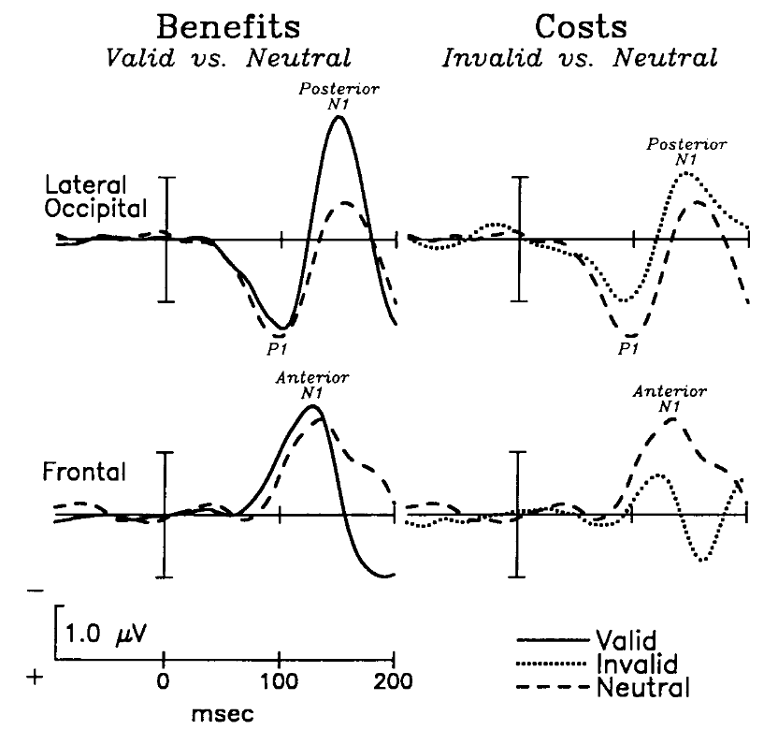
ERP evidence for early selection
Spatial cuing
/ Exogenous (stimulus-driven) cueing
Luck et al. (1994)
P1: Neutral > Invalid
⇒ Cost of attentional allocation in terms of stimulus detectability
N1: Valid > Neutral
⇒ Benefit of attentional allocation in terms of stimulus detectability

Slide 12
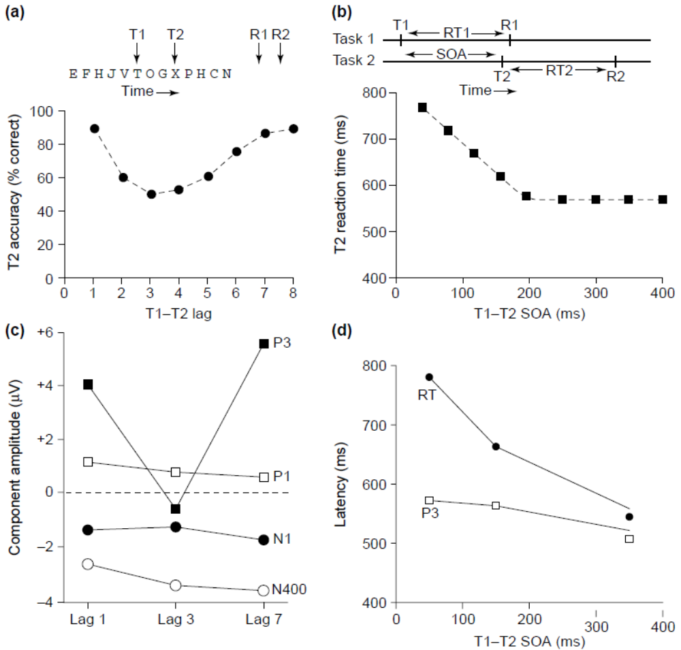
ERP Evidence for Late Stage Selection
Attentional Blink
Psychological refractory period
P3 reflect updates of working memory
Attentional blink => interaction of attention & WM
Psychological refractory => the lateralized readiness potential – response processing

Slide 13
Multiple subsystems view of attention
Early and late selection effects
=> Attention operates across a variety of cognitive sub-systems:
Early sensory analysis
Working memory
Response selection & execution

Slide 14
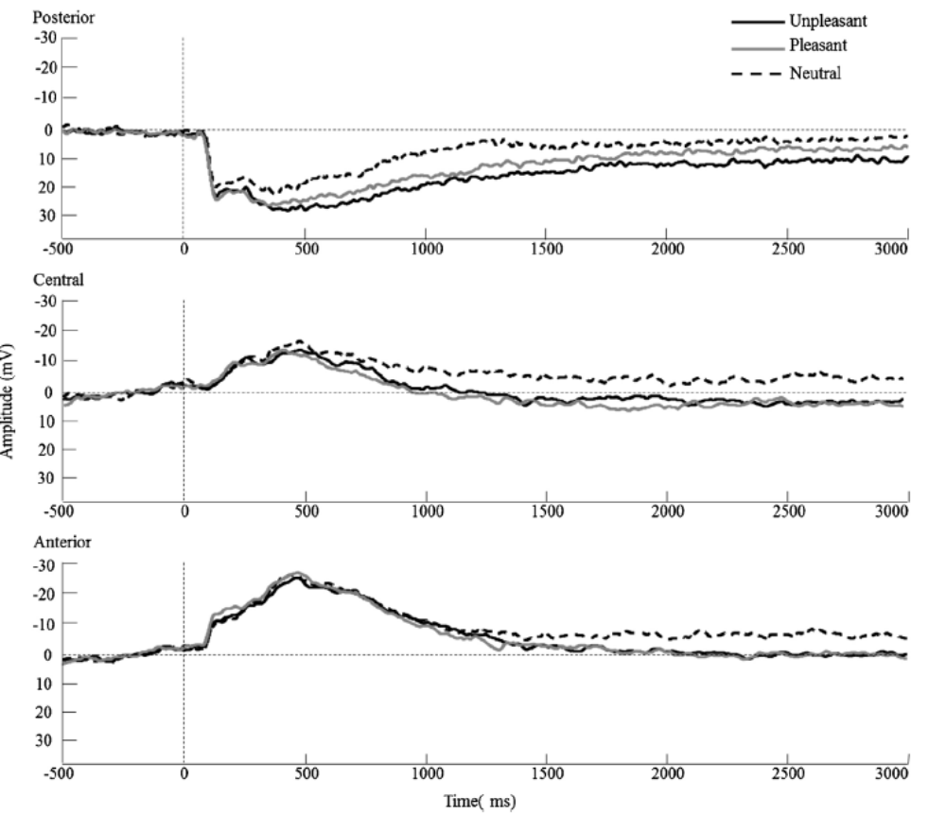
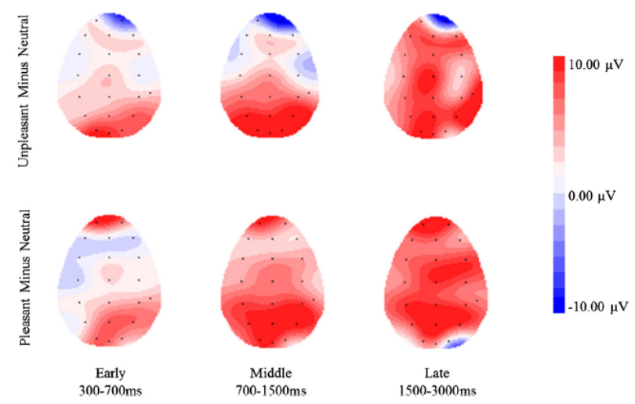
Emotion processing: LPP
Late positive potential (LPP): Reflecting ongoing and elaborative processing of motivationally salient stimuli.
Passive viewing of affective picture
(Hua et al., 2014)

Slide 15
Summary
A link between ERPs and the specific psychological or neural process that the component reflects.
General problems:
Forward Inference
Reverse Inference
a given process -- a given ERP component ?

